Slide 1


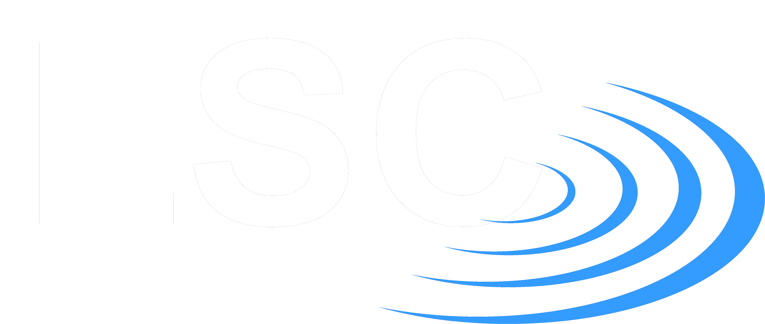

Making cutting-edge research more relevant to students
Chris North
Cardiff University School of Physics and Astronomy

Slide 2
Gravitational waves in schools
Predicted by Einstein in 1916 in General Relativity
Directly detected in 2015 by LIGO eperiment
Topical, but often inaccessible
Extreme physics and numbers
Not explicitly on school syllabus
But basic concepts are:
  Waves
  Interference
  Resonance
  gravity

Slide 3
Workshop Objectives
Help A-level Physics students understand gravitational waves
  Based on previous knowledge from studies
  Using equipment in school physics labs
Increase relevance of studies to gravitational waves

Slide 4
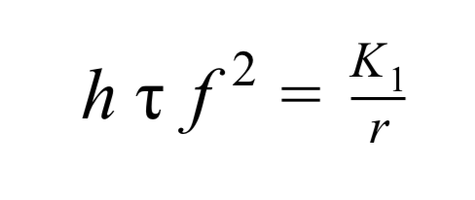
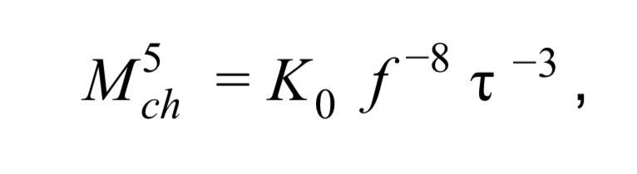
Workshop outline
Introduction to gravitational waves [15 mins]
Break into breakout groups (practical & theory) [2x45 mins]
  Groups of 4
  Mix year 12 & 13 where appropriate
  Uses cutting-edge simulations data
Overview and future

Slide 5
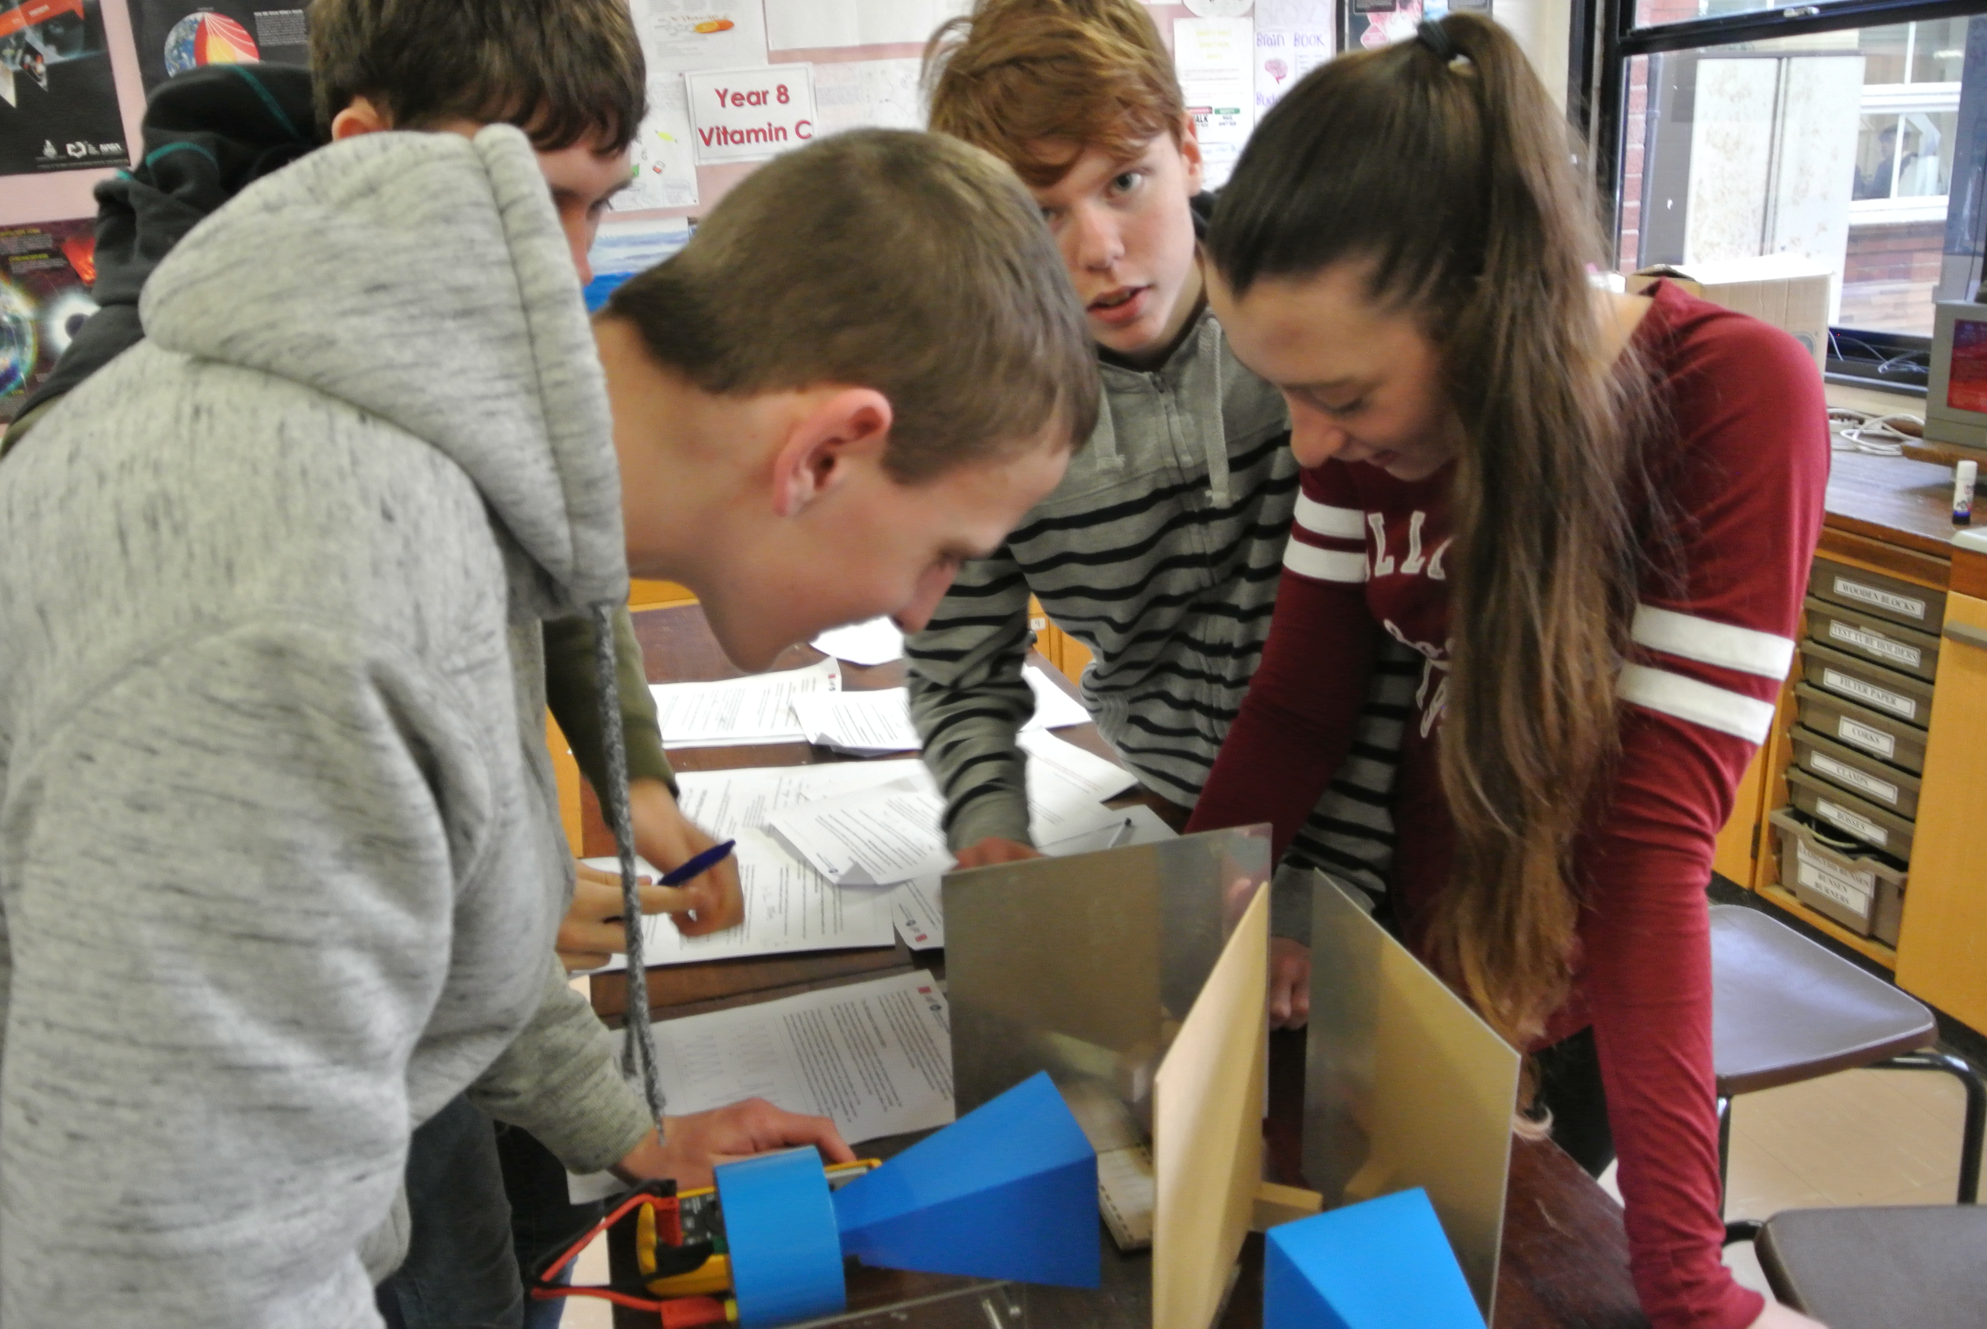
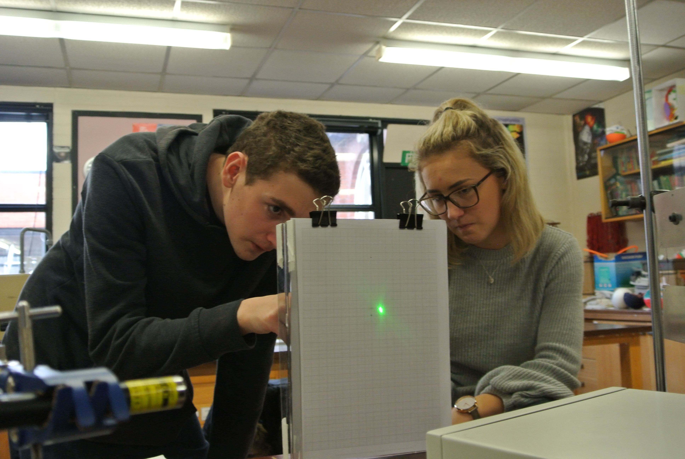
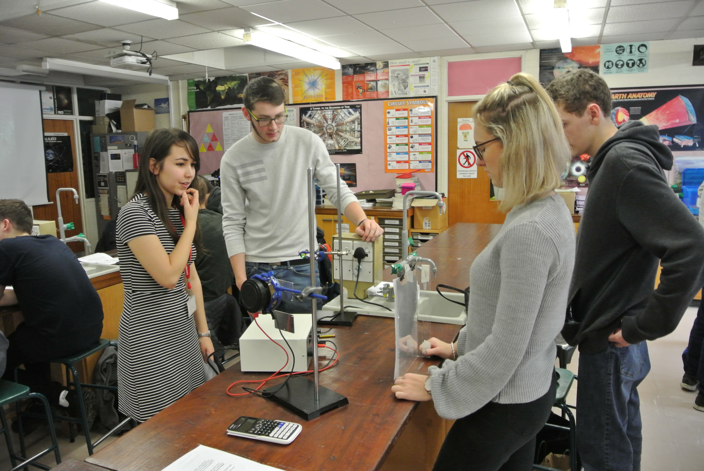
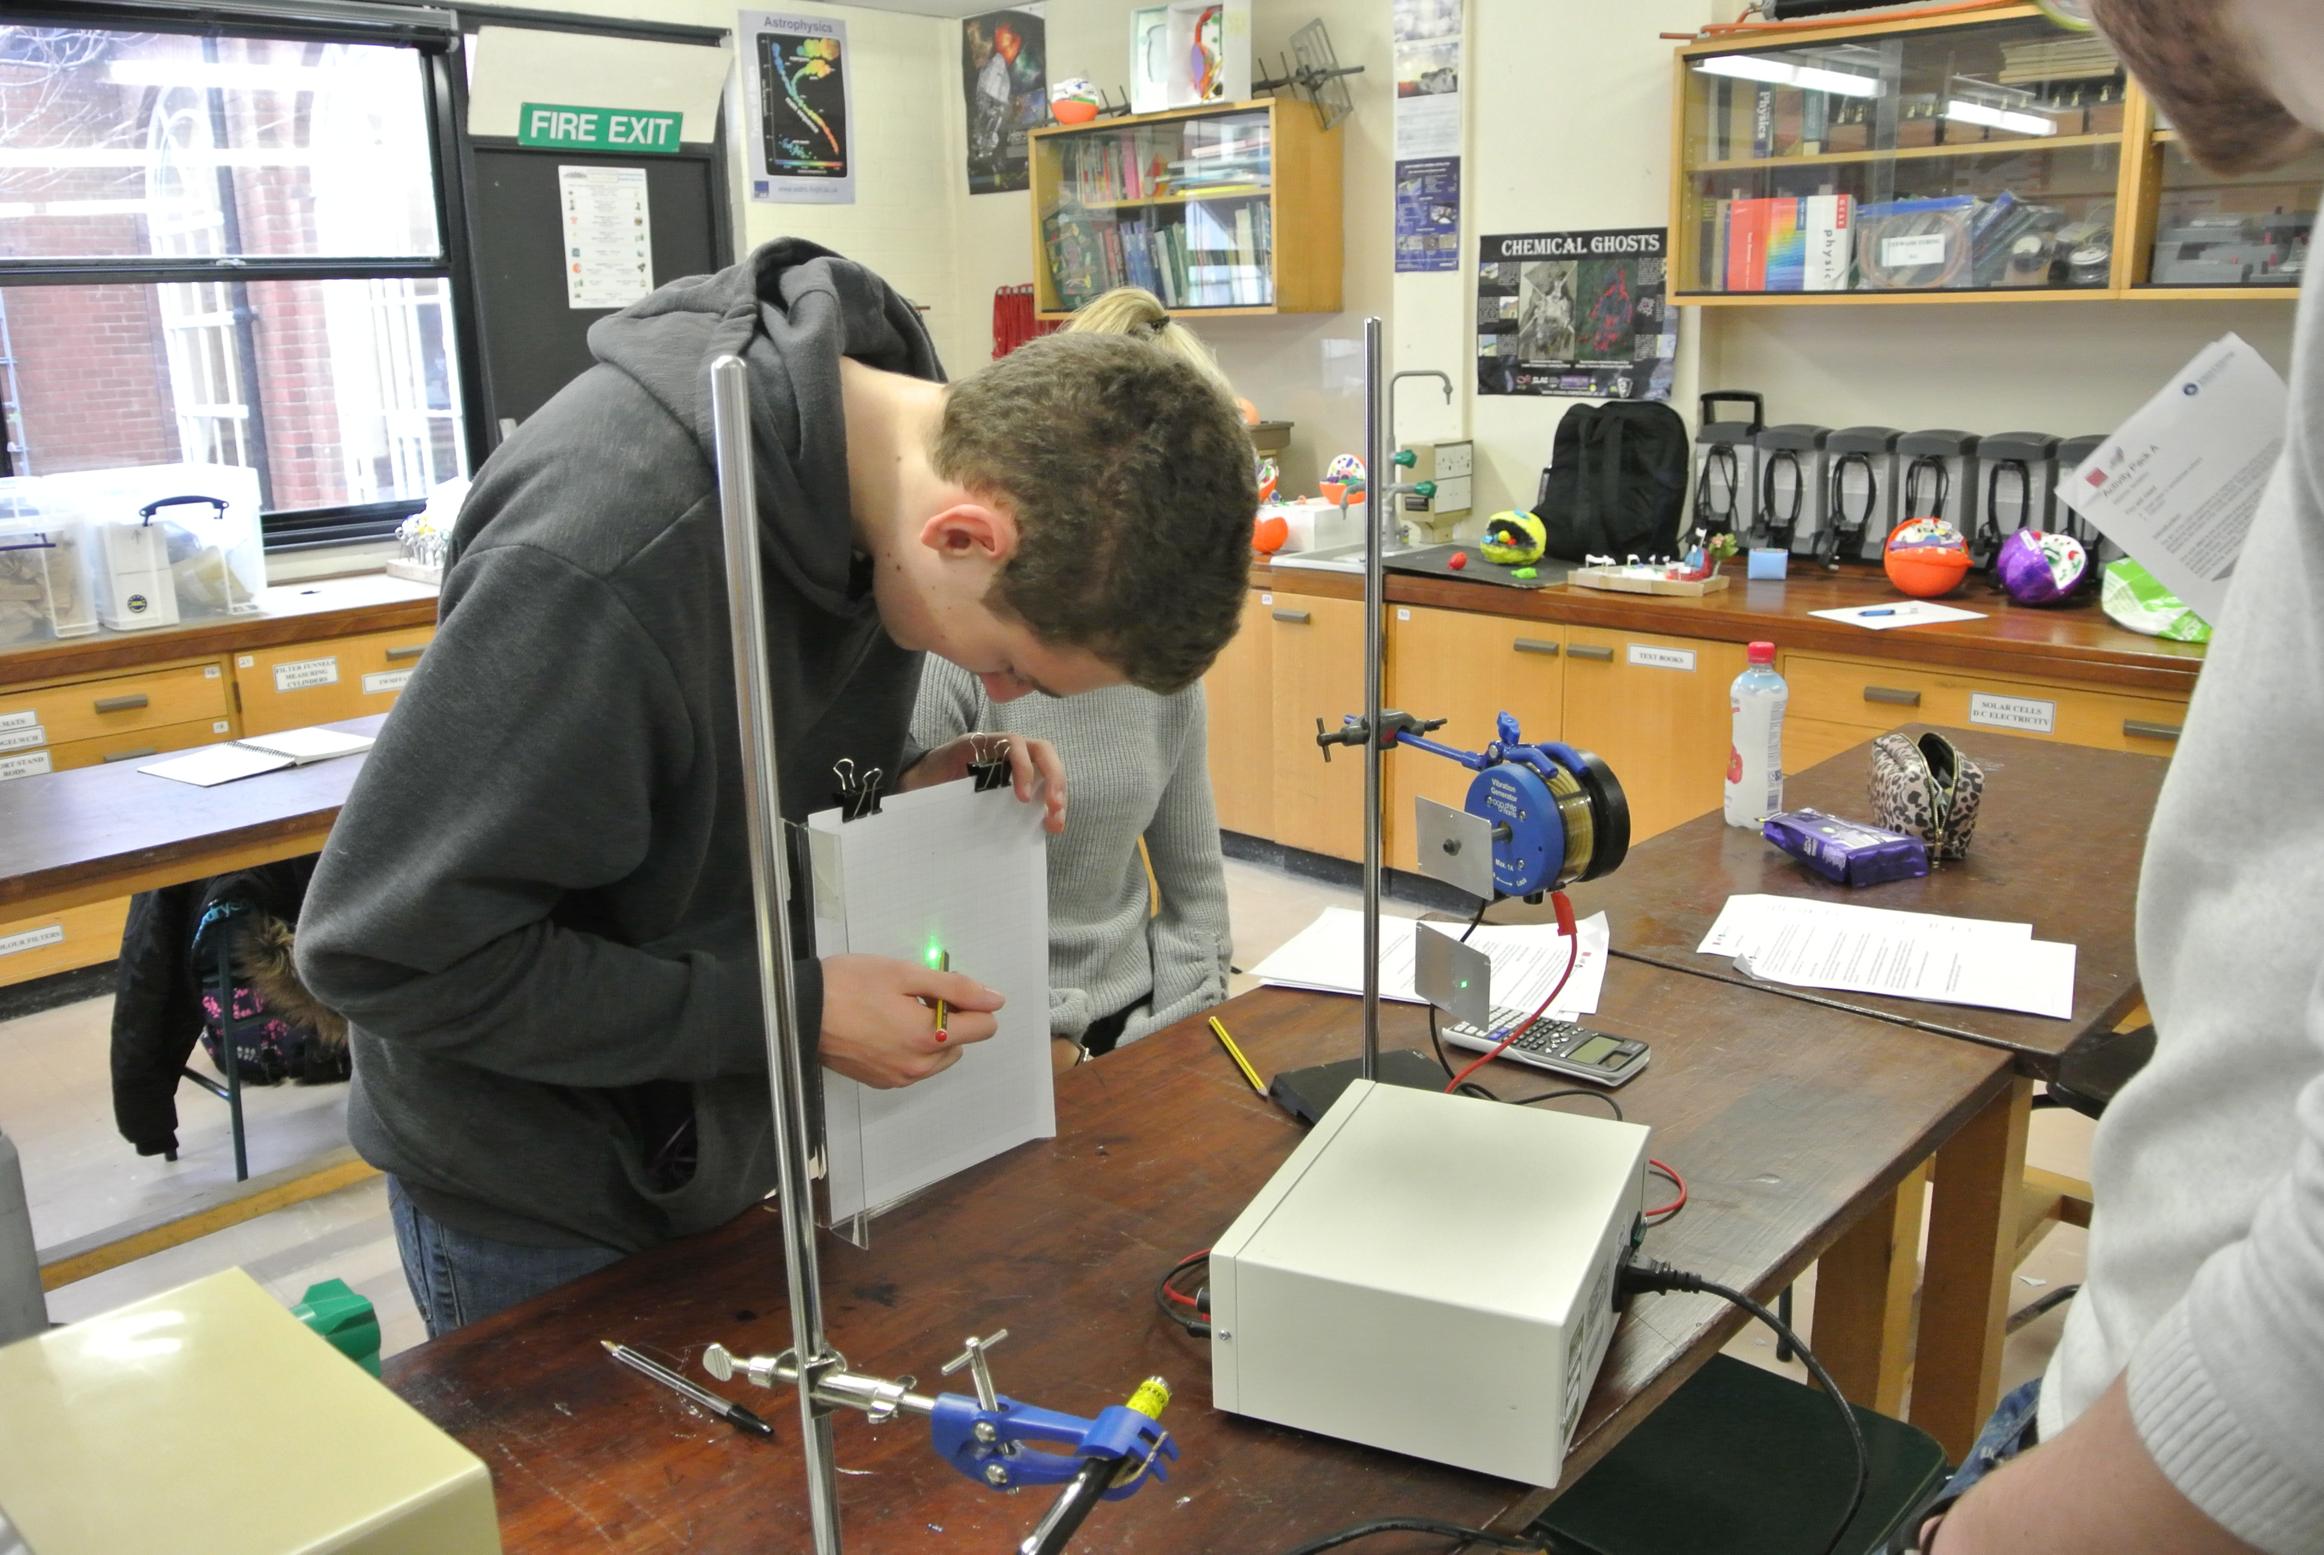

Slide 6
Pre-evaluation
Science capital
Post-18 intentions
“Gravitational waves capital”
How well do you think you understand gravitational waves? [1-10]
How relevant do you think what you learn in A-level physics is to understanding gravitational waves and their detection?

Slide 7
Post-evaluation
Was the workshop pitched at the right level?
Did you feel involved in the workshop?

Slide 8
Results – Science/GW capital

Slide 9
Results - engagement

Slide 10
Results - relevance

Slide 11
Results - Change in relevance

Slide 12
Results – enjoyment/interest

